Slide 1

Domain Adversarial Training
신경망응용및실습 두번째 프로젝트
Daehyun Cho
Cognitive System Lab
A.I. Dept, Korea Univ.
2021-12-05
1

Slide 2

Index
1
Proposed Project
2
Methods
3
Results
4
Discussion
Cogsys Lab

Slide 3
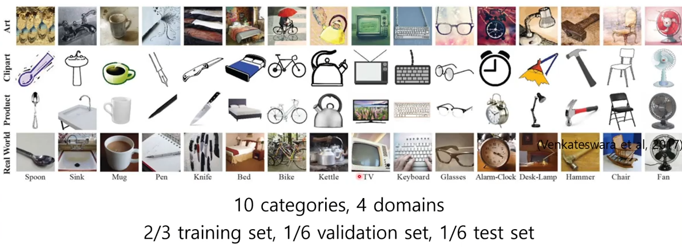
Domain Generalization
Train classification task of different datasets of styles(=domain).
There are several approaches to this task.
1
Proposed Project
[Fig. 1] OfficeHome dataset samples and splits from proposal.
https://www.youtube.com/watch?v=uN8z4pyL2N4
Cogsys Lab, Daehyun Cho

Slide 4
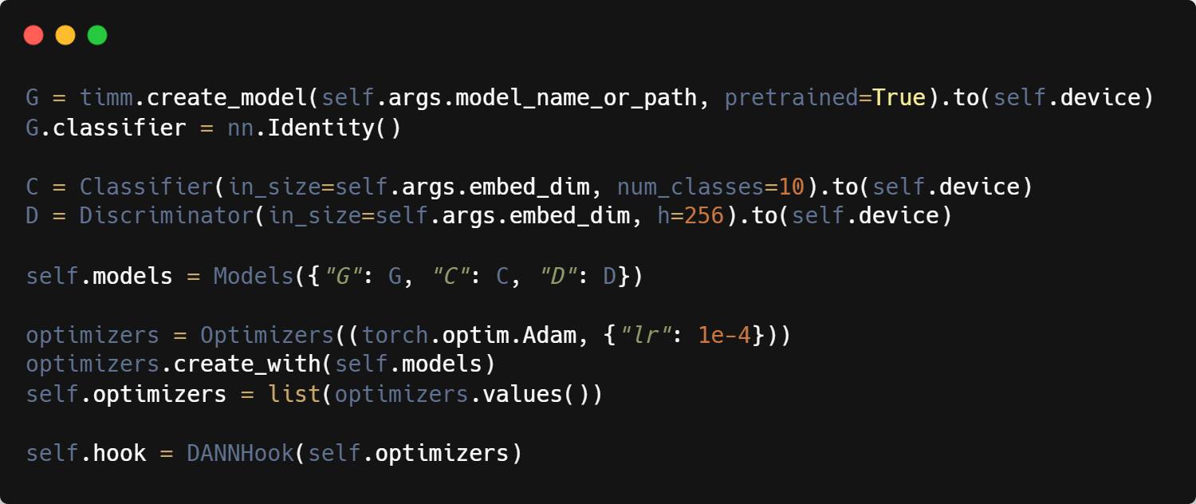

DANN Implementation with PyTorch Adapt
Simple framework to implement several approaches for domain adaptation.
I also used DANN from the proposal.
2
Methods
[Fig. 2] PyTorch adapt example.
https://github.com/KevinMusgrave/pytorch-adapt
https://medium.com/@tkm45/deep-domain-adaptation-using-pytorch-adapt-c020ae596e25
Cogsys Lab, Daehyun Cho

Slide 5
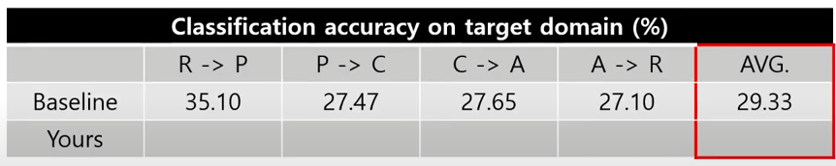
Models
Since there was a hardware limit, I used MobileNetV3 and ResMLP-distilled.
Both models were implemented with the help of timm.
Adam
LR=1e-4
Epochs=20
Tests
From baseline, I got this result.
I have also tested in reverse way.
2
Methods
[Table. 1] Baseline performance from proposal.
Cogsys Lab, Daehyun Cho

Slide 6
DANN Results (Accuracy/AUROC)
Since there was a hardware limit, I used MobileNetV3 and ResMLP
3
Results
Models | R→P | P→C | C→A | A→R | Average.
Baseline | 35.10 | 27.47 | 27.65 | 27.10 | 29.33
MobileNetV3 | 87.76 98.21 | 41.24 85.07 | 66.04 96.15 | 80.53 97.85 | 68.89 94.32
ResMLP12 Distilled | 52.04 88.01 | 22.68 79.04 | 45.28 88.68 | 70.8 96.27 | 47.7 88.0
[Table. 1] Baseline comparison with my model. Depicted values are accuracy and auroc in %.
Models | P→R | C→P | A→C | R→A | Average.
MobileNetV3 | 79.91 95.37 | 72.98 94.90 | 58.66 89.45 | 76.81 96.73 | 72.05 94.075
ResMLP12 Distilled | 9.37 50.0 | 8.83 53.49 | 9.30 48.69 | 60.87 85.18 | 22.05 59.34
[Table. 2] Reversed training of source and target.
Cogsys Lab, Daehyun Cho

Slide 7
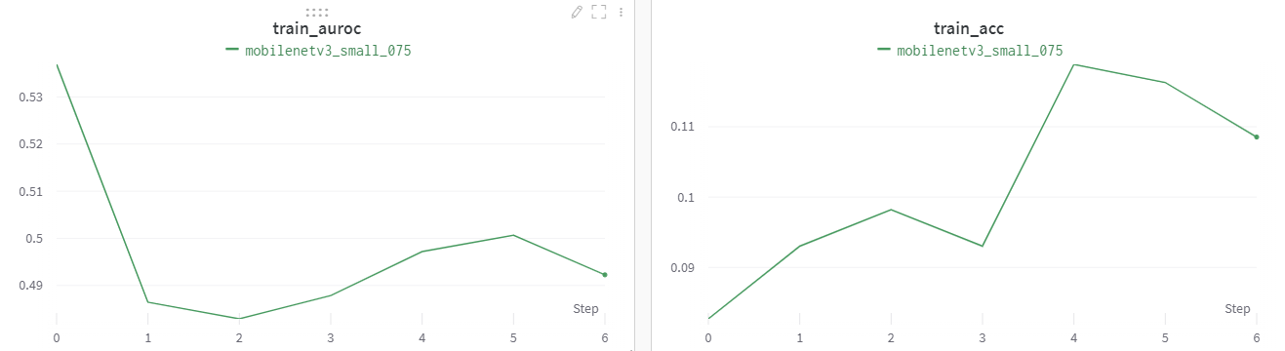
Training: Non-pretrained Models
Since there was small portion of data only, it was inevitable to use pretrained models.
Non-pretrained models fail to optimize in random initialization state.
3
Results
[Fig. 3] Non-pretrained model training curve for source data (Art → Clipart).
Cogsys Lab, Daehyun Cho

Slide 8
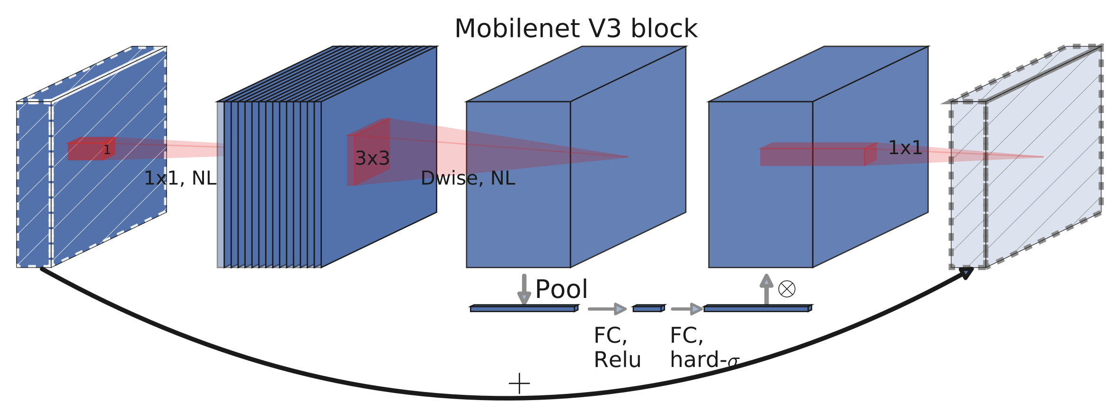
Training: MobileNetV3
MobileNet V3 is NetAdapt Algorithm applied NAS searched architecture.
Efficiency of the model was highly increased and reduced latency compared to the preceeding version.
3
Results
[Fig. 4] MobileNet V3 Basic Block Description.
Cogsys Lab, Daehyun Cho

Slide 9
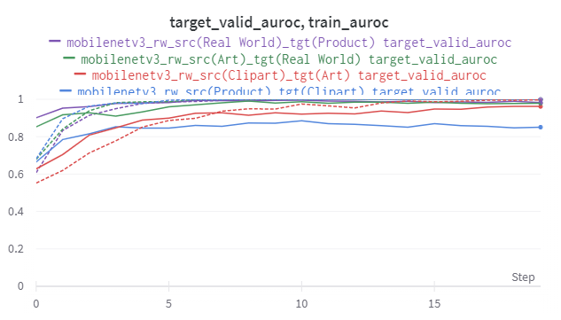
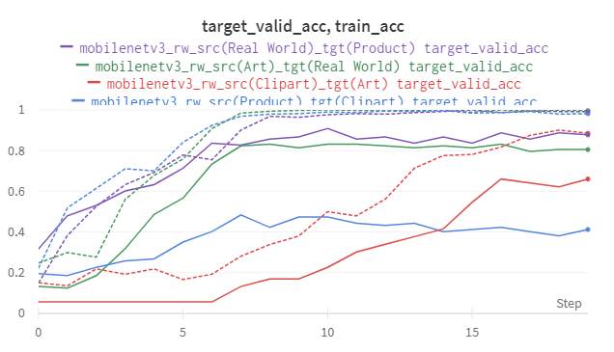
Training: MobileNetV3
Pretrained version optimizes very well and shows high performance.
3
Results
[Fig. 5] AUROC, ACC of source(dashed) and target(plain) line of MobileNet V3 Pretrained.
Cogsys Lab, Daehyun Cho

Slide 10
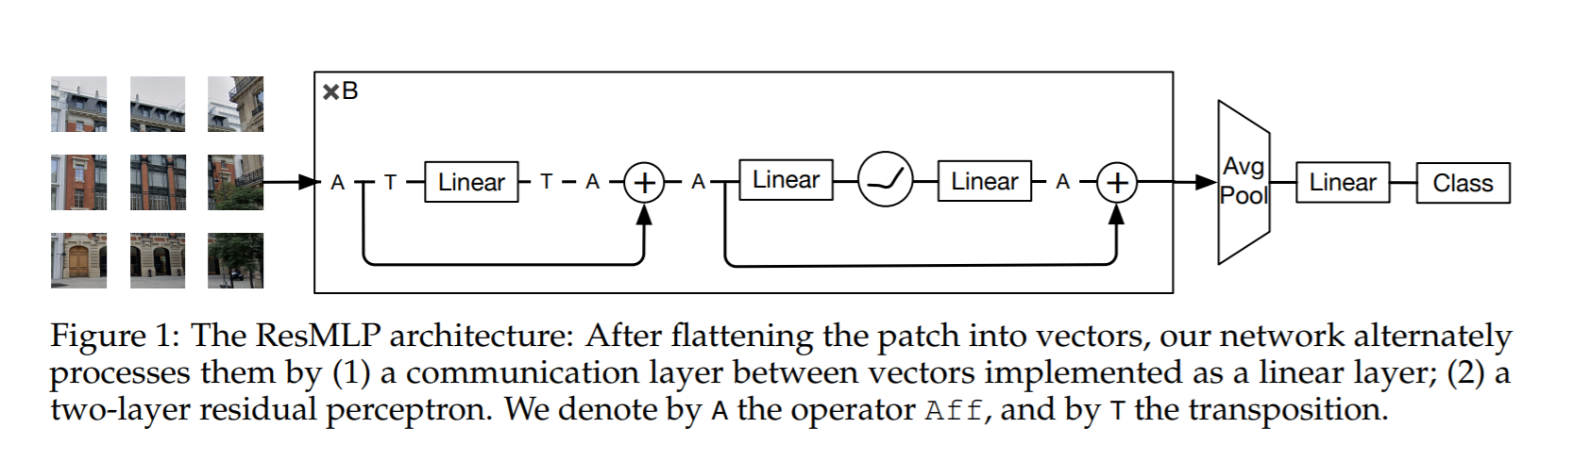
Training: ResMLP-12-distilled
Mixed-MLP was recently proposed multi-layer perceptron architecture for computer vision.
Here I used 12 layers model.
3
Results
[Fig. 6] ResMLP Architecture and description.
https://arxiv.org/abs/2105.03404
https://github.com/rishikksh20/ResMLP-pytorch
Cogsys Lab, Daehyun Cho

Slide 11
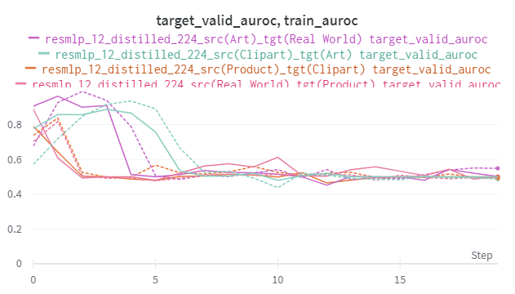
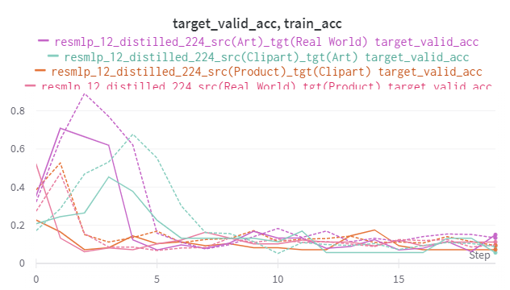
Training: ResMLP-12-Distilled
Pretrained model shows relatively high performance in early stages, but fails to optimize.
This is due to sensitive configurations for attention networks.
3
Results
[Fig. 7] AUROC, ACC of source(dashed) and target(plain) line of ResMLP-12-distilled
Cogsys Lab, Daehyun Cho

Slide 12
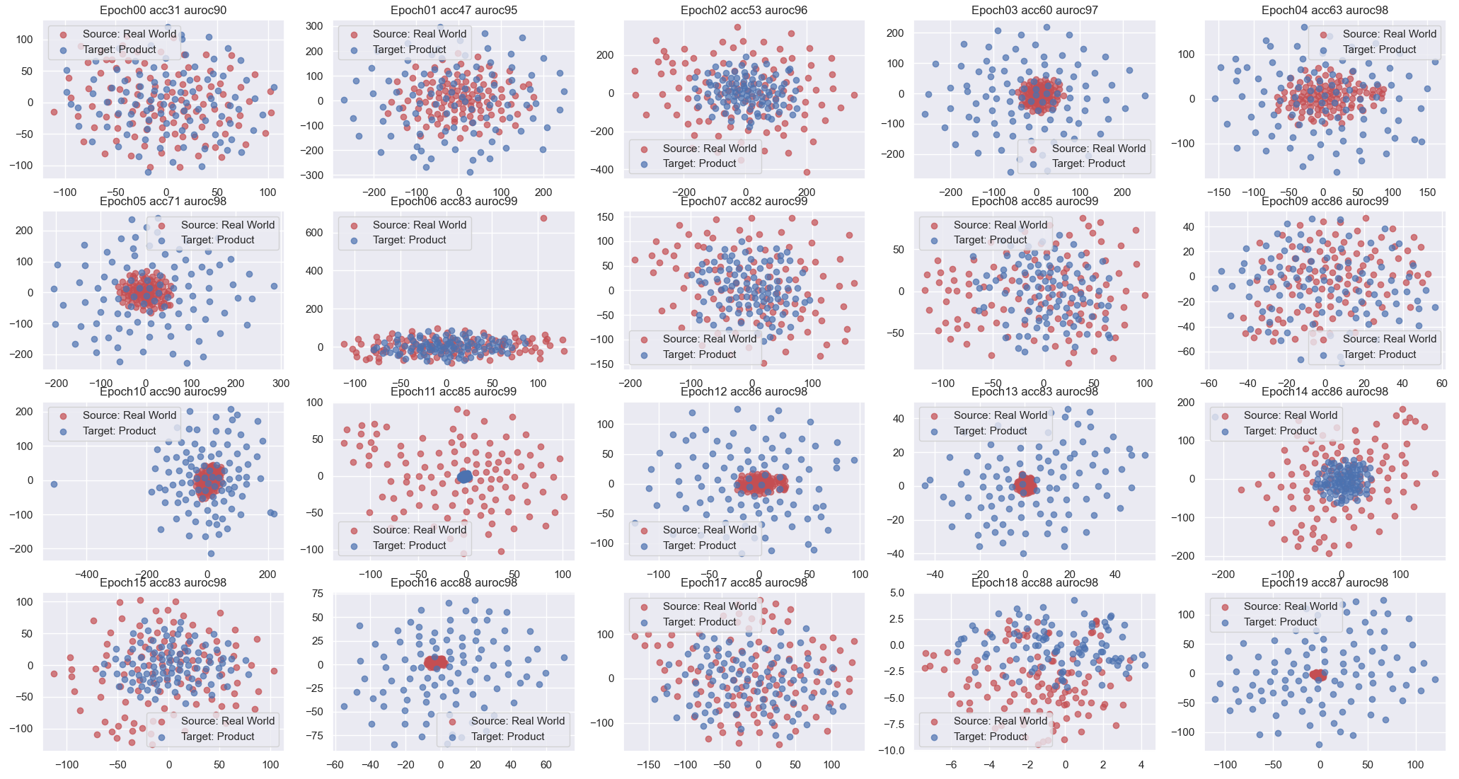
Real World to Product TSNE result on valid dataset. MobileNetV3 (87.76% acc)
Source is embedded cohesively while target is not.
3
TSNE Results
[Fig. 8] TSNE result by MobileNetV3 during the training.
Cogsys Lab, Daehyun Cho

Slide 13
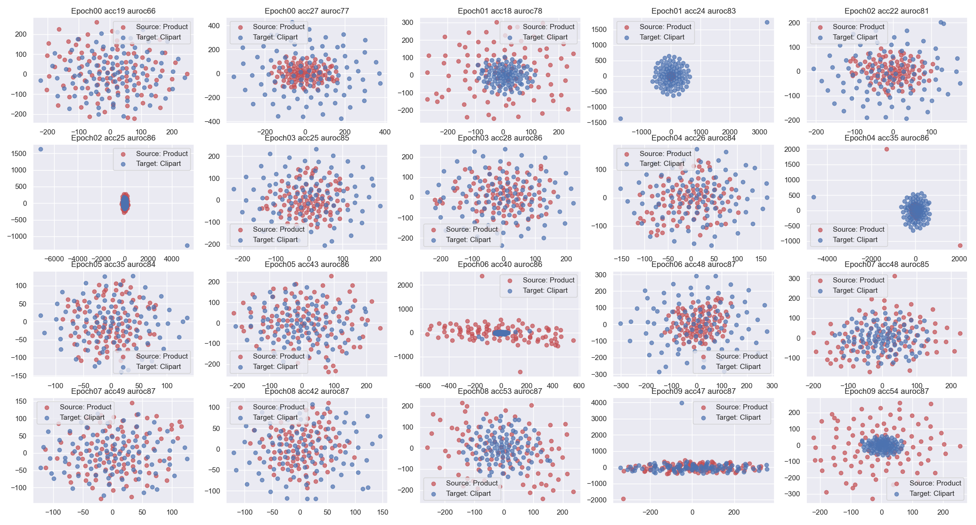
Product to Clipart TSNE result on valid dataset. MobileNetV3 (41.24% acc)
Interestingly, target was cohesive too.
3
TSNE Results
[Fig. 9] TSNE result by MobileNetV3 during the training.
Cogsys Lab, Daehyun Cho

Slide 14
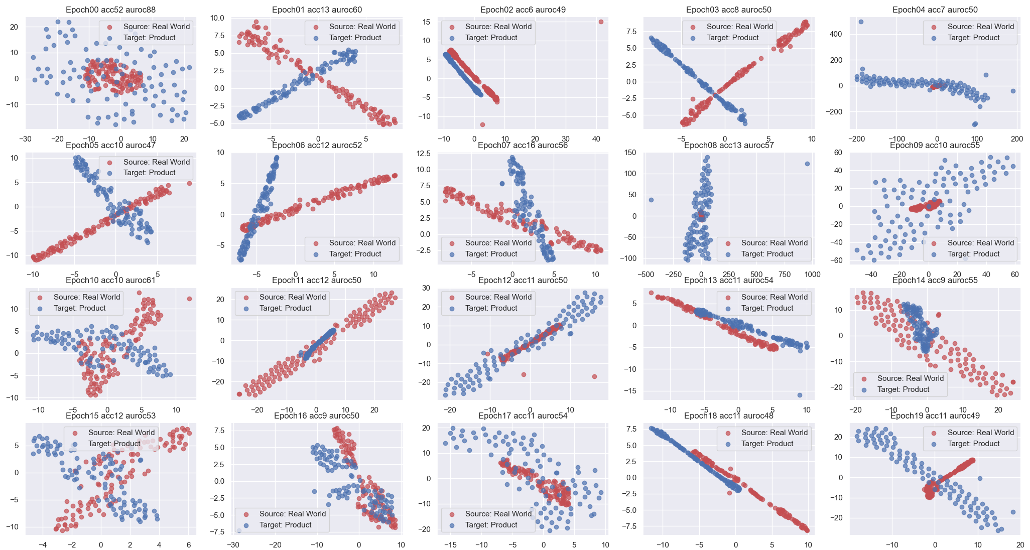
Real World to Product TSNE result on valid dataset. ResMLP (52.04% acc)
ResMLP tends to embed everything in linear way.
3
TSNE Results
[Fig. 10] TSNE result by ResMLP during the training.
Cogsys Lab, Daehyun Cho

Slide 15
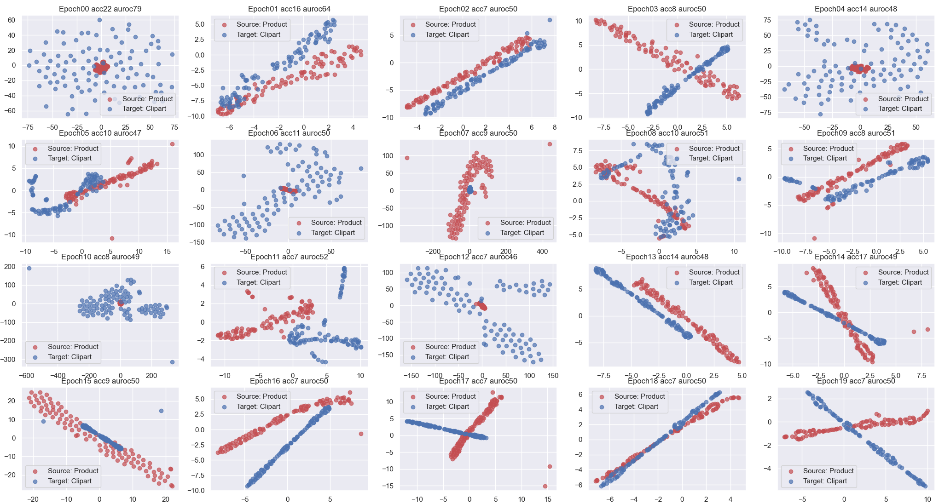
Product to Clipart TSNE result on valid dataset. ResMLP (22.68% acc)
ResMLP tends to embed everything in linear way.
3
TSNE Results
[Fig. 11] TSNE result by ResMLP during the training.
Cogsys Lab, Daehyun Cho

Slide 16
Take-aways
Through PyTorch-Adapt, we can easily implement several methods of domain adaptation.
However, we still need to think of how to generalize all 4 datasets, and extend to general images.
There was a shortage of data – 1,800 data in total (including all datasets)
Cohesiveness was not significantly observable and fluctuates very much during the training.
MobileNetV3 and ResMLP show different tendency in TSNE embeddings
Would be interesting to see how unsupervised/semi-supervised image models would work here.
4
Discussion
Cogsys Lab, Daehyun Cho

Slide 17
Thank you 🙏
https://github.com/1pha/DomainGeneralization
Daehyun Cho
Cogsys Lab, AI Dept
1phantasmas@korea.ac.kr
Cogsys Lab

